Slide 1
Capstone project
Prepared by:
Fernando Noe Flores Ramirez
April 27th, 2021

Slide 2
Introduction – business understanding
My project is related to design a proof of concept application which may provide valuable information to guests to choose venues regarding their location of interest and previous ratings using API information.
We have used two locations in Tokyo area and points of interest are sushi restaurants and ratings come from Foursquare using API.

Slide 3
data
Data comes from Foursquare using API to get locations and ratings
As input data we use postal codes of location of interest, in our case, two hotels in Asakusa and Shinjuku cities.
Using Python code, as output data we get venues around the sites of interest and transform it into dataframes to handle information obtained from Foursquare.
Using Folium we visualize locations in maps – Google Maps

Slide 4
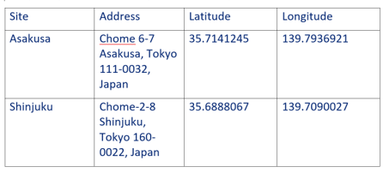
Input Data
Getting coordinates, latitude and longitude of initial sites of interest using postal addresses, Google Maps API was used for this step.

Slide 5
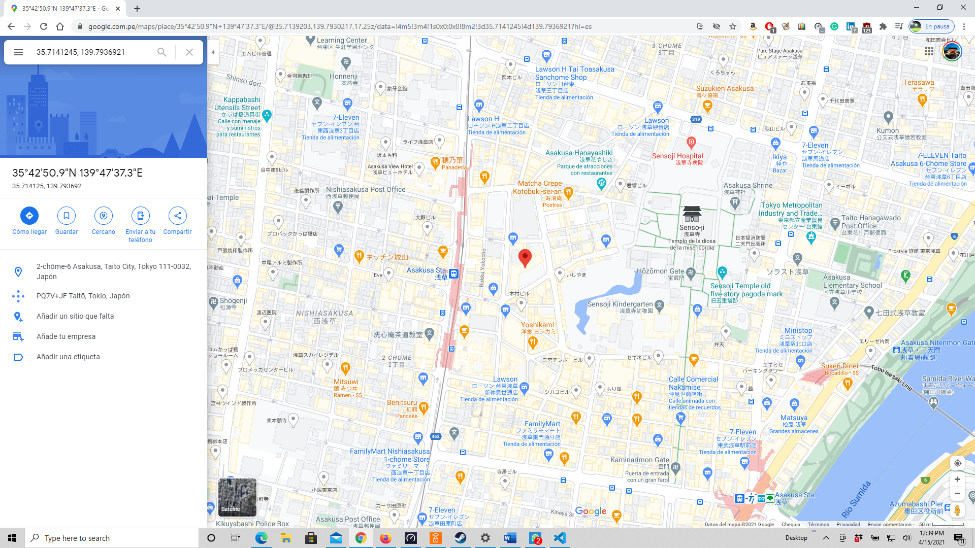
Location
Site visualization using Folium library.
Asakusa site - Chome 6-7 Asakusa, Tokyo 111-0032, Japan

Slide 6
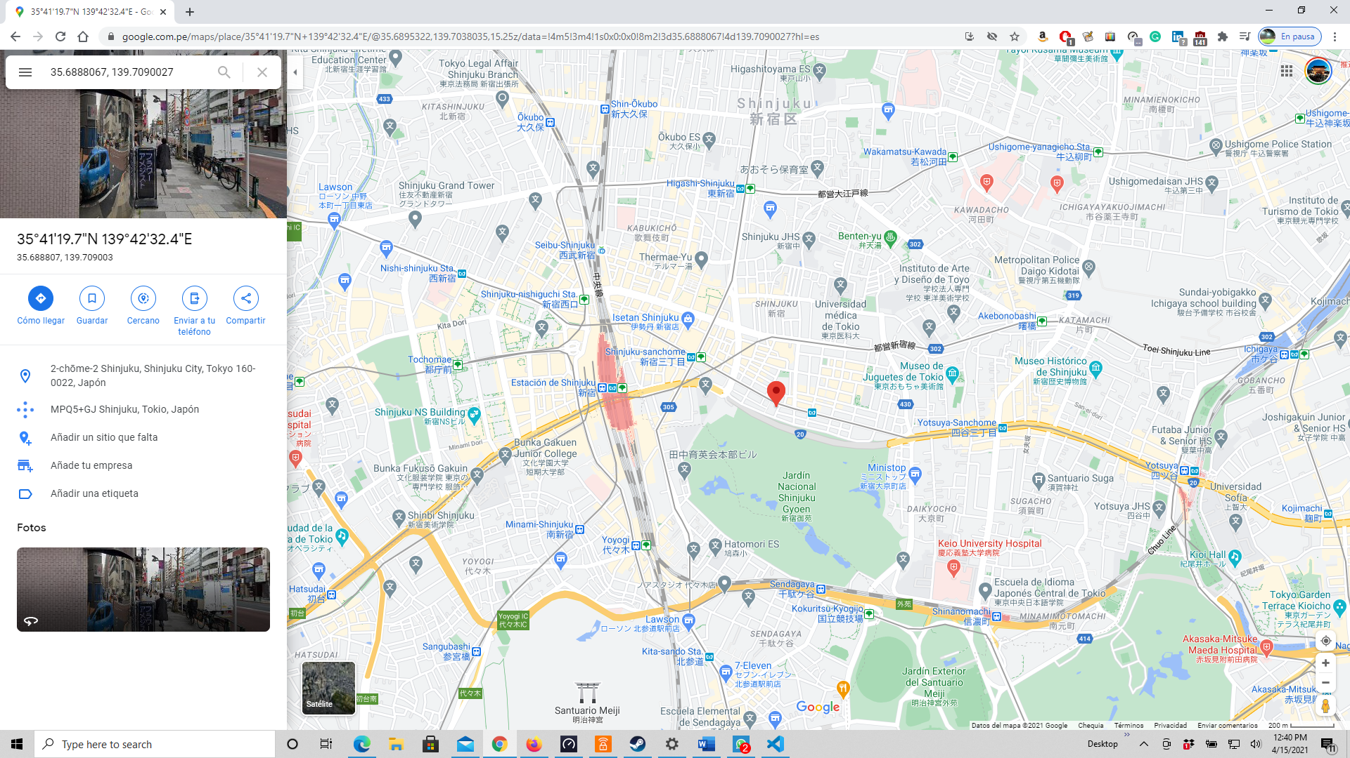
Location
Site visualization using Folium library.
Shinjuku site - Chome-2-8 Shinjuku, Tokyo 160-0022, Japan

Slide 7
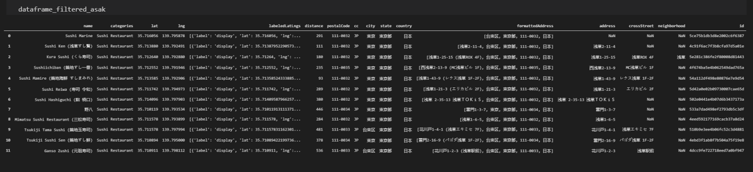
Data output
Using coding, we get a dataframe per site
dataframe_filtered_ask shows the list of venues near Asakusa site.
We got several attributes per site (columns), ID, location attributes are required for next step

Slide 8
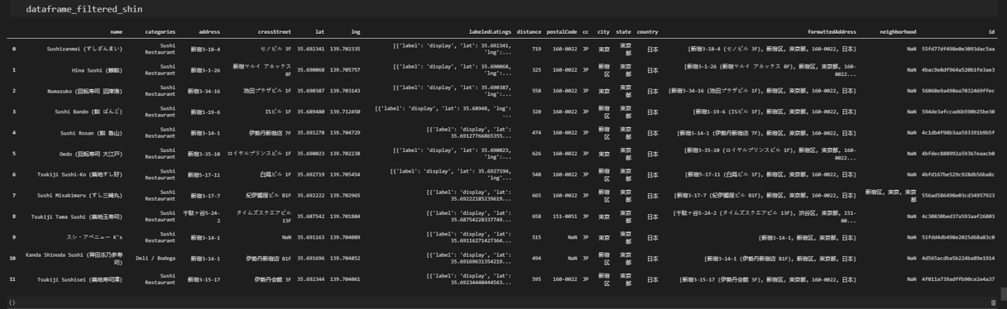
Data output
Using coding, we get a dataframe per site
dataframe_filtered_shin shows the list of venues near Shinjuku site.
We got several attributes per site (columns), ID, location attributes are required for next step

Slide 9
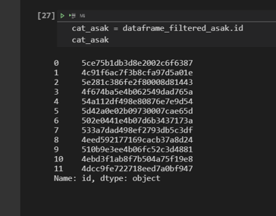
Data output
cat_asak object shows the venues ID list regarding Asakusa site
This data will be the input to get ratings per venues.

Slide 10
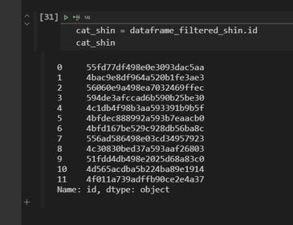
Data output
cat_shin object shows the venues ID list regarding Shinjuku site
This data will be the input to get ratings per venues.

Slide 11
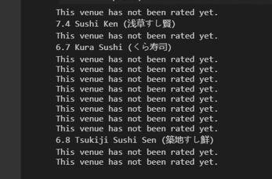
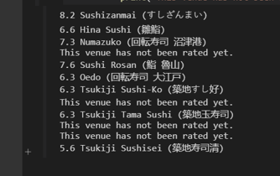
Data output
Using Foursquare API and venues IDs identified, we found the ratings per venue.

Slide 12
results
Shinjuku – Sushizanmai – 8.3
Shinjuku - Sushi Rosan – 7.6
Asakusa – Sushi Ken - 7.4
Shinjuku – Numazuko – 7.3
Combining outputs per site, we merge the ratings based on the desired criteria, i.e. rating more than 7.0
Shinjuku is the winner site, more sushi restaurants with more than 7.0 in ratings

Slide 13
conclusions
Python and key libraries like Pandas, Folium and Geopy were used, furthermore, Google Maps API -which was more accurate than Geopy in this case.
Foursquare API managed getting location and rating information, using GitHub repository and Jupyter Notebook and Visual Studio Code linked with GitHub account, synchronization feature is key.
Thanks to Pedro Pessoa who provides me valuable feedback, guidelines and excellent support in coding to improve my capstone project.

